Slide 1

PROJEPCT ON DATA ANALISTE
Project Name:-Predicting Housing Sale price By Sawant Mayur Sunil

Slide 2
outiline
INTRODUCTION
PROBLEM STATEMENT
PIPELINE
EDA
BASE MODEL
VISUALIZATION
MODEL CREATION
MODEL SELCTION
CONULUCTION

Slide 3
introduction
In this project, we have build machine learning model to predict the house price.
Housing sales price are determined by numerous factors such as material quality , number of rooms , area of garage
We will apply numerus regression models and will find out the most optimal model with maximum R-squared value and minimum MSE

Slide 4
Problem statement
It is critical to provide accurate predictions of housing sale price.
With increasing demand of housing price of house are going up.

Slide 5
pipeline
BASE MODEL
Importing Libraries
EDA
VISUALIZATION
MODEL CRICTION
MODEL SELCTION

Slide 6
EDA
Data reding
Finding null values
Fel na and dropna
Drop those column who’s have 2 to 4 category but near to 75% or 75% value to one category

Slide 7
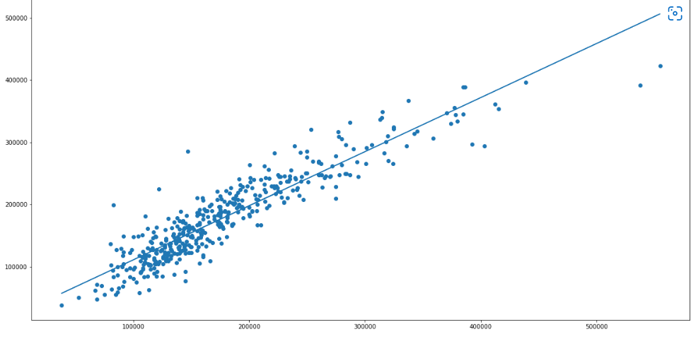
Base model
In this process, we are going to build bas model of linear regression model
This is use to further analysis with different e model
The model have R-squared =0.7965422 and Adjusted R-squared=0.79143027
The base model has MSE=8.41875079*e8 & RMSE=29015.0836

Slide 8
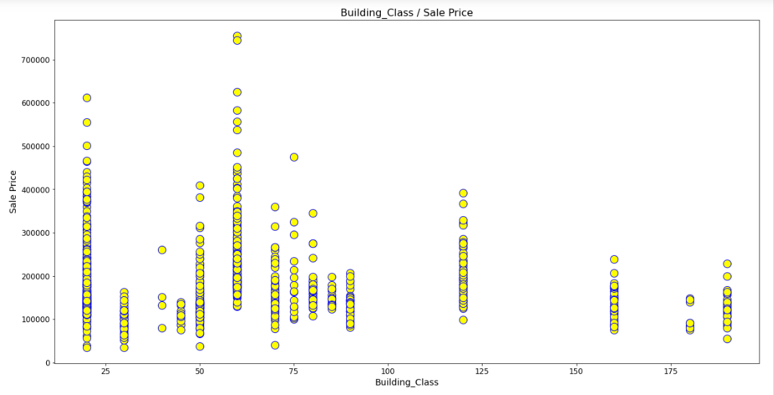
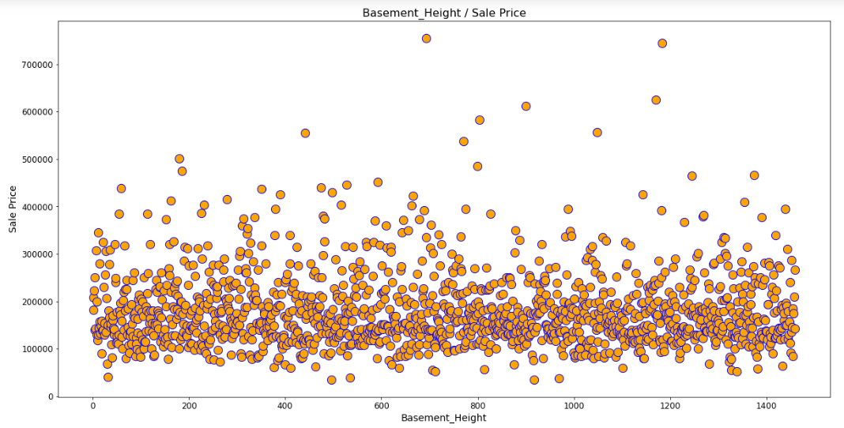
VISUALIZATION
1)Heatmap :- Heatmaps are very useful to find relations between two variables in a dataset. Heatmap can be easily produced using the ‘heatmap’ function provided by the seaborn package in python
2) Scatter plot :- a scatter plot is also used to observe linear relations between two variables in a dataset. In a scatter plot, the dependent variable is marked on the x-axis and the independent variable is marked on the y-axis.

Slide 9
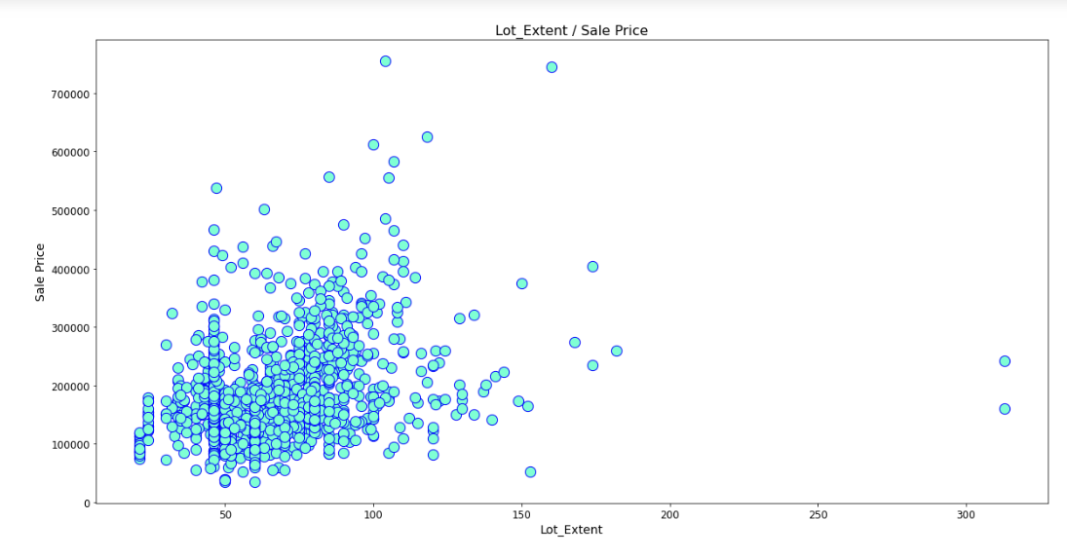
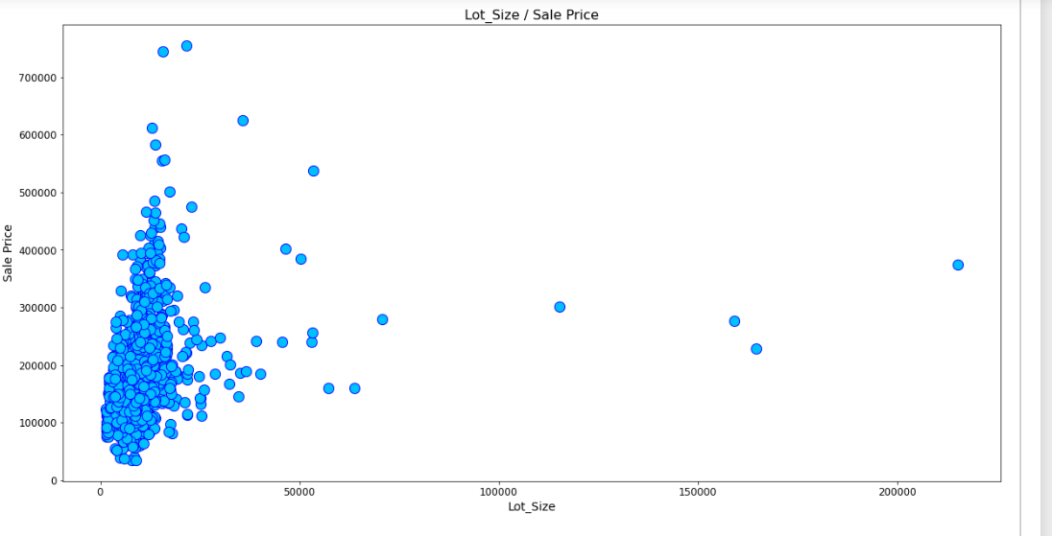
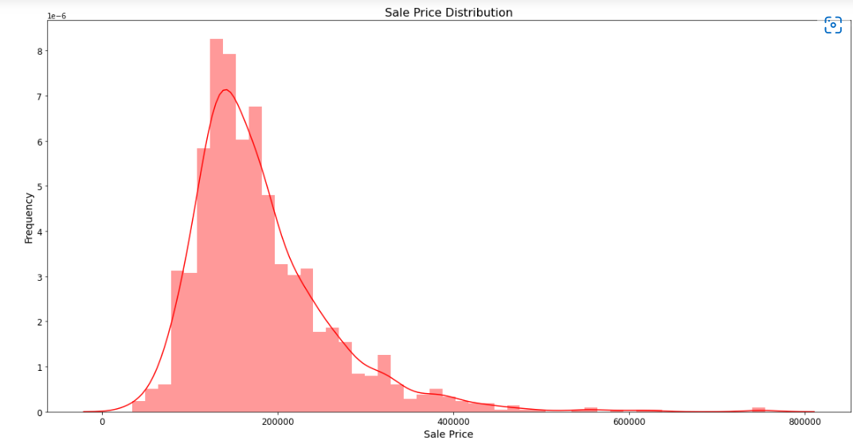
Distribution Plot:-Distribution plots are very useful to check how well a variable is distributed in the dataset. Let’s now produce a distribution plot using the ‘distplot’ function to check the distribution of the ‘SalePrice’ variable in the dataset

Slide 10
MODEL CREATION
FEATURE SELECTION & DATA SPLITE
In this process we are going to define the ‘X’ variable (independent variable) and the ‘Y’ variable (dependent variable). After defining the variables, we will use them to split the data into a train set and test set. Splitting the data can be done using the ‘train_test_split’ function provided by scikit-learn in python.
In this process, we are going to build and train five different types of linear regression models which are the ln model, Ridge regression model, Lasso regression model, Elastic Net regression model. For all the models, we are going to use the pre-built algorithms provided by the scikit-learn package in python.

Slide 11
MODEL SELCTION
Model Name | R-squared | Adjusted R-squared | MSE | RMSE
Base Model | 0.7965422 | 0.79143027 | 8.41875079*e8 | 29015.0836
Linear Regression | 0.8673760 | 0.86447015 | 5.2938 | 2.3008
Ridge | 0.86737603 | 0.86447015 | 5.3829 | 2.3009
Lasso | 0.82492853 | 0.82109261 | 6.5839 | 2.5659
Elastic Net | 0.84072009 | 0.83723017 | 5.9249 | 2.4340
Random Forest Regressor | 0.97959130 | 0.97914411 | 6.053027 | 2.4602
By above table evaluate our model liner regression model have high R-squared and MSE is low as compare to other than model

Slide 12
CONULUCTION
66661.72773996553
Although the linear regression model that was created in this post is not perfect, it is able to account for approximately 86.7% of the variation in Sale Price of a property, and it also is able to predict the Sale Price within 387018.01Further exploration of the residuals of this model revealed a specific weakness in this model at predicting extreme values. Specifically, the range for predictions appeared to be within to 66661.72 to 387018.01.
Thank you
If you have any suggestion ,please give me feedback
If you have any question then ask me.

